Slide 1
Matrix decomposition
Matrix decomposition (also called matrix factorization) is a process of breaking a matrix into a product of simpler or more structured matrices. It's a core concept in linear algebra used widely in:
Solving systems of linear equations
Data compression
Machine learning

Slide 2
Why decompose a matrix?
Matrix operations (like solving Ax=b) can be computationally expensive. Decomposition helps by turning a complex matrix into simpler parts that are easier to work with.

Slide 3
The Core Idea
You start with a matrix A, and decompose it, A=M1⋅M2⋅M3….
These smaller matrices can be:
Diagonal
Triangular
Orthogonal (rotation/reflection matrices)
Sparse
Simpler in some computational way
These simpler matrices can have special properties that make them faster to compute with, easier to invert and more interpretable

Slide 4
Spectral Decomposition (Eigen Decomposition)
Spectral Decomposition is a way of expressing a real, square, symmetric matrix using its eigenvalues and eigenvectors.
Spectral Decomposition (also called Eigen decomposition) is a method used to break down a square symmetric matrix into its eigenvalues and eigenvectors. It’s a fundamental concept in linear algebra, especially useful in systems analysis, quantum mechanics, and data science.

Slide 5
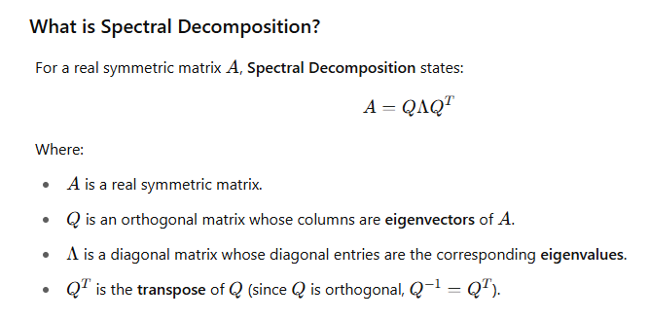

Slide 6
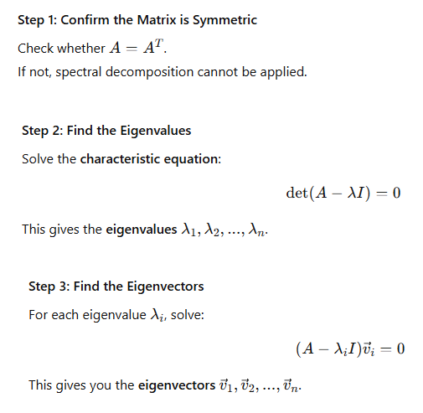

Slide 7
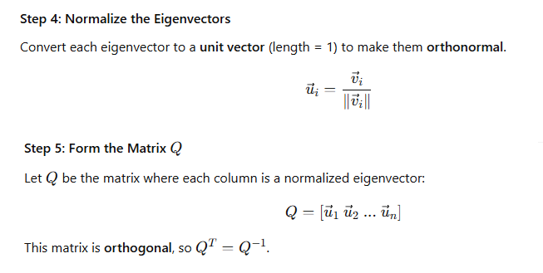

Slide 8
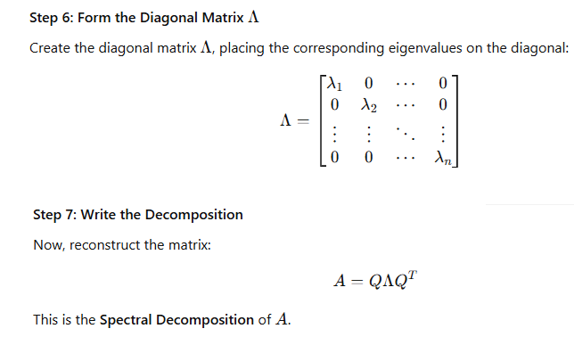

Slide 9
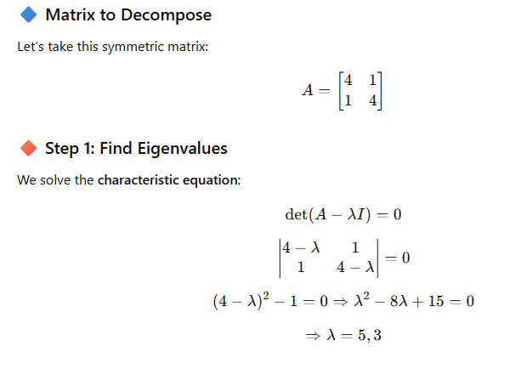

Slide 10
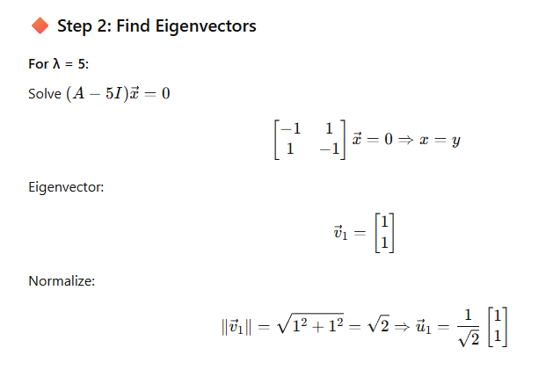

Slide 11
